Slide 1

Subject Code: SCSA1303 Subject Name: Software Engineering

Slide 2

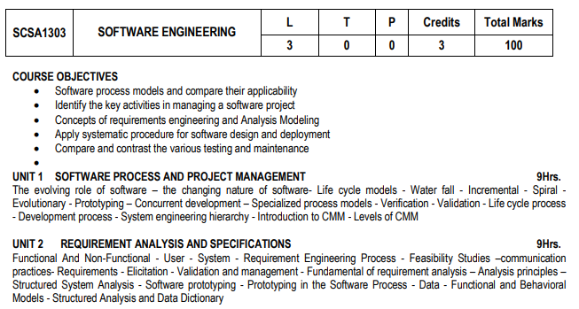

Slide 3
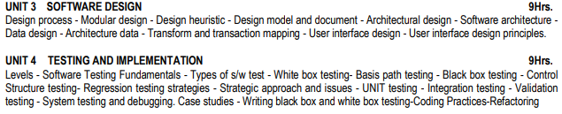

Slide 4
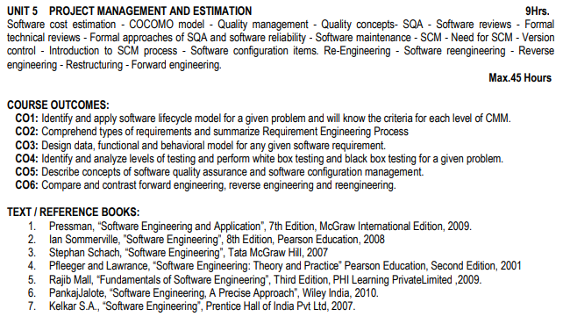

Slide 5
Unit – II-REQUIREMENT ANALYSIS AND SPECIFICATION
Functional And Non-Functional - User - System - Requirement Engineering Process - Feasibility Studies –communication practices- Requirements - Elicitation - Validation and management - Fundamental of requirement analysis – Analysis principles – Structured System Analysis - Software prototyping - Prototyping in the Software Process - Data - Functional and Behavioral Models - Structured Analysis and Data Dictionary.

Slide 6

Objective
To describe functional and non-functional requirements
To introduce the concepts of user and system requirements
To explain Requirement Engineering Process for Collecting the requirements
To explain how software requirements may be organised in a requirements document

Slide 7
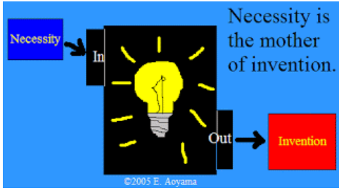
What is a requirement?

Slide 8
SDLC(Software Development Life Cycle)
The process used as the framework for software Development
Project Manager and Business organisation use SDLC as a blue print for completing each step of the lifecycle for software development

Slide 9
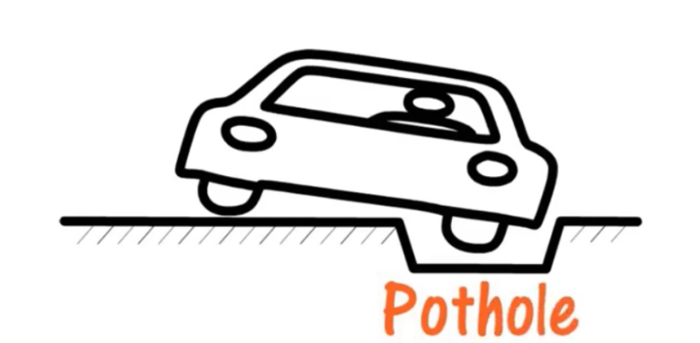
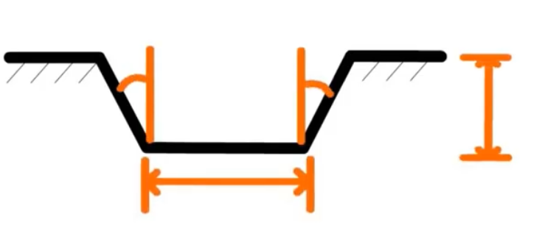
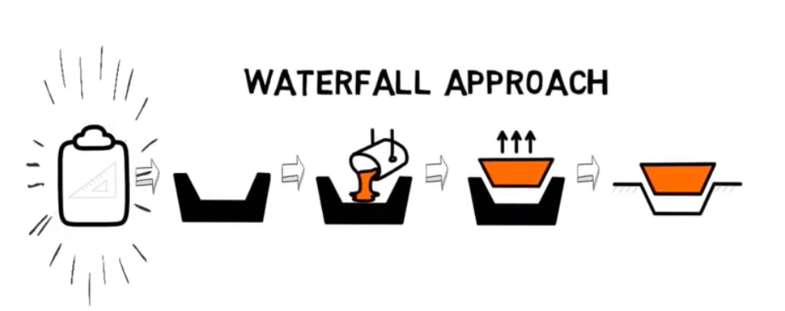
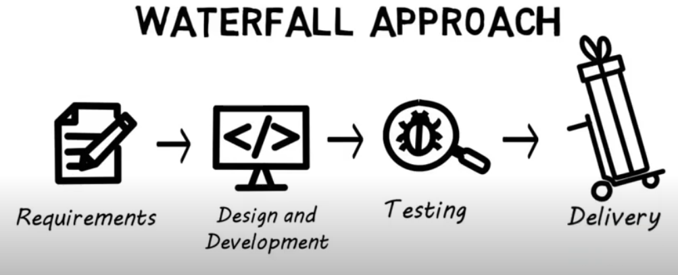
Water Fall Model
Requirements Know well

Slide 10
Reason for Mismatch in the end
product from Customer Expectation
Incorrect implementation of customer requirements, faulty design, a wrong understanding of customer requirements by programmers and quality team, etc.

Slide 11
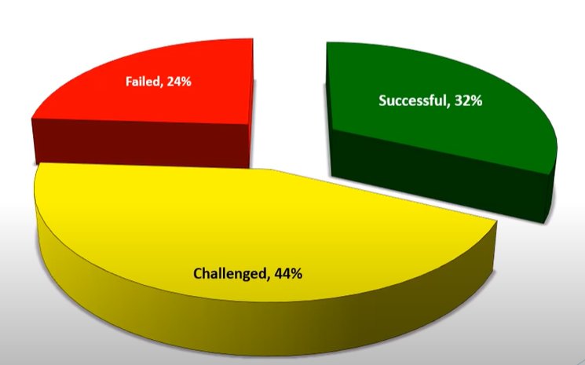
Statistics of Successful, Challenged and Failed Project

Slide 12
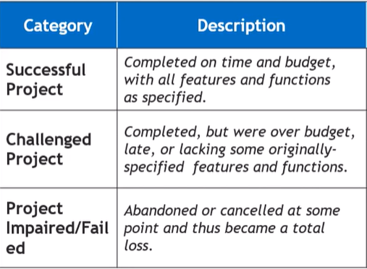
Description of Successful, Challenged and Failed Project

Slide 13
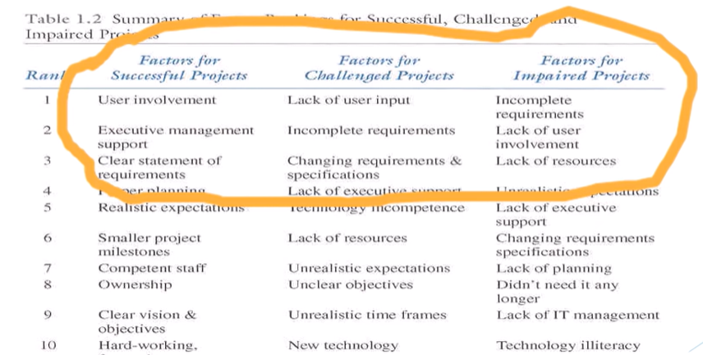
Reason for Successful, Failure and Challenged Project

Slide 14


Slide 15
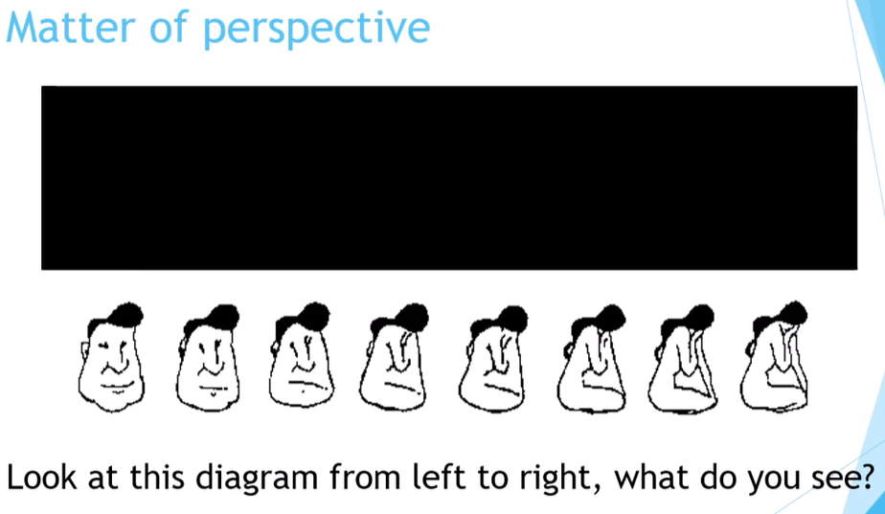

Slide 16
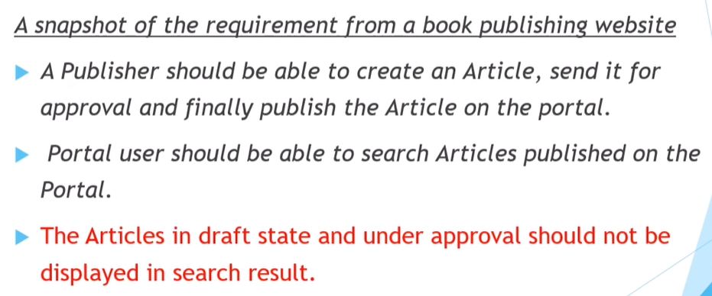

Slide 17

Requirement Collected from Stakeholders

Slide 18
System Requirement

Slide 19
What is a requirement?
A condition or capability needed by a user to solve a problem or achieve an objective.
A condition or capability that must be met or possessed by a system or system component to satisfy a contract, standard, specification, or other formally imposed documents.
It may range from a high-level abstract statement of a service or of a system constraint to a detailed mathematical functional specification.
A requirement should not be just a single word nor a whole story.
A good business requirement should contain a specific structure

Slide 20
Business Problem
Banker owns banking business . His bank is not using any software as of now the report shows drop in number of customers due to lack of internet banking facility. So decides to invest in banking Software.
He invites people from software development firm and make them to understand the business problem and expectation from the software.

Slide 21
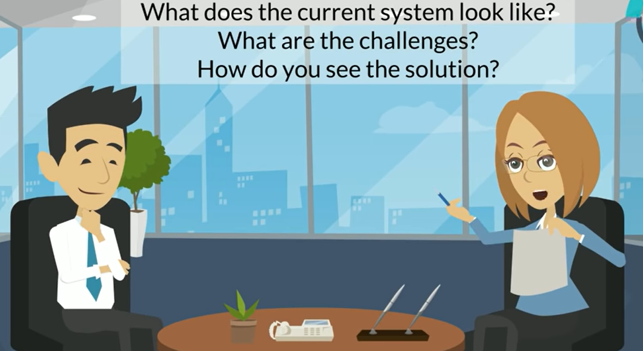
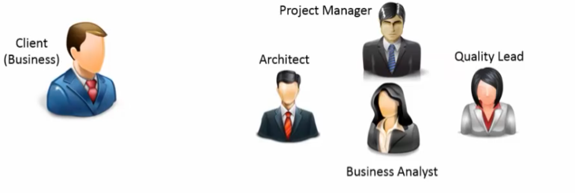
Case Study-Banking Software

Slide 22
Main Resources:
To Understand Business Problem and find a solution
Project Manager- Plan the Deadline and Budget and lead the Project
Software Architect- understand the technical feasibility of the requirement
Business Analyst-Good knowledge about the business domain
Quality Lead-Certifies whether the product can be delivered and met the expectation of the customer

Slide 23
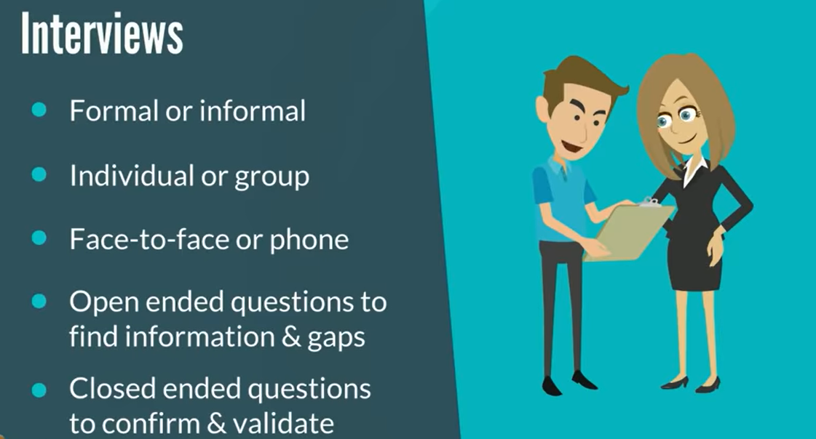
Main Sources for Requirement Collection:

Slide 24
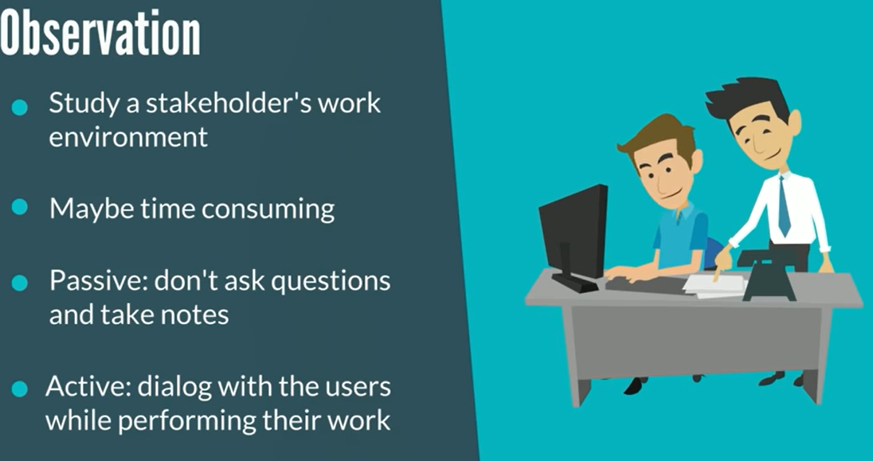
Main Sources for Requirement Collection:

Slide 25
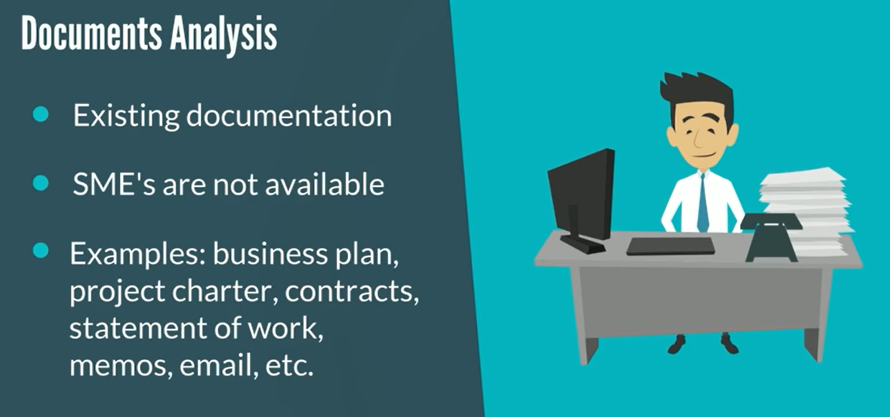
Main Sources for Requirement Collection:

Slide 26
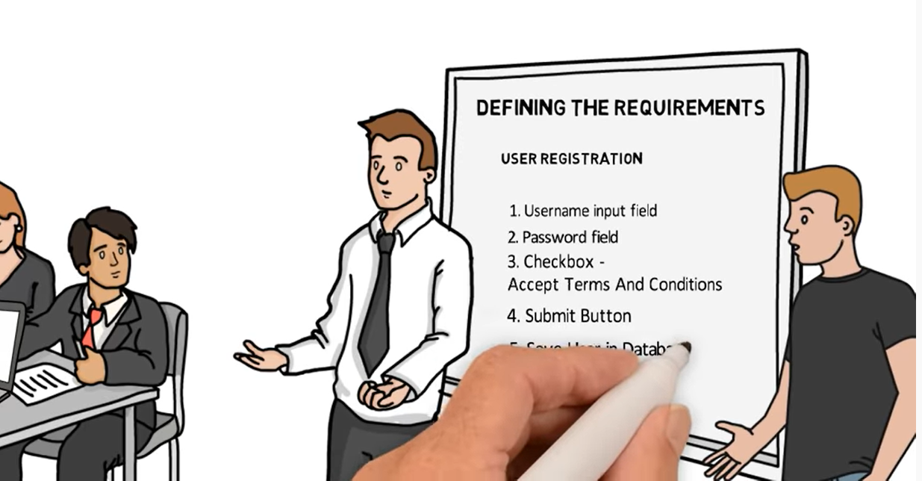
Main Sources for Requirement Collection:

Slide 27

Main Sources for Requirement Collection:

Slide 28
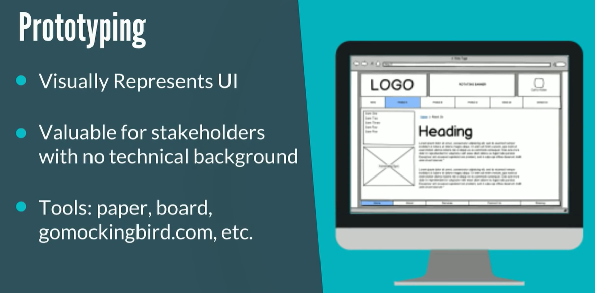
Main Sources for Requirement Collection:

Slide 29
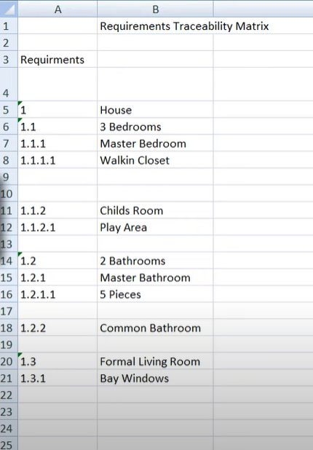
Main Sources for Requirement Collection:

Slide 30

Requirements Collected Successfully by the Team

Slide 31
Functional and Non functional Requirements
User must enter login credential to do transaction-functional requirement
Website should withstand 500 simultaneous users to the bank website without web server going down or performance degrade-non functional requirement

Slide 32
Types of requirement
Functional Requirement(Needs)
Non Functional Requirement(Wants)

Slide 33
Functional and Non-Functional Requirement:
Functional requirements are those which are related to the technical functionality of the system.
Non-functional requirement is a requirement that specifies criteria that can be used to judge the operation of a system in particular conditions, rather than specific behaviors.

Slide 34

What is a Functional Requirement?
In software engineering, a functional requirement defines a system or its component(what the system should do).
The list of actual services which a system will provide.
List of services which a user want from the software
It describes the functions a software must perform. A function is nothing but inputs, its behavior, and outputs.

Slide 35
What is a Functional Requirement?
Functional software requirements help you to capture the intended behavior of the system.
This behavior may be expressed as functions, services or tasks or which system is required to perform.

Slide 36
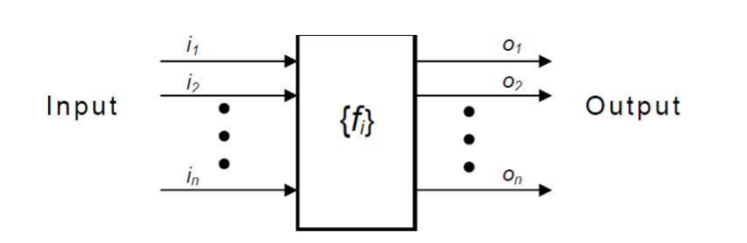
What is a Functional Requirement?

Slide 37

Example of Functional Requirements
The software automatically validates customers against the ABC Contact Management System
The Sales system should allow users to record customers sales
Searching a Book in Library System

Slide 38
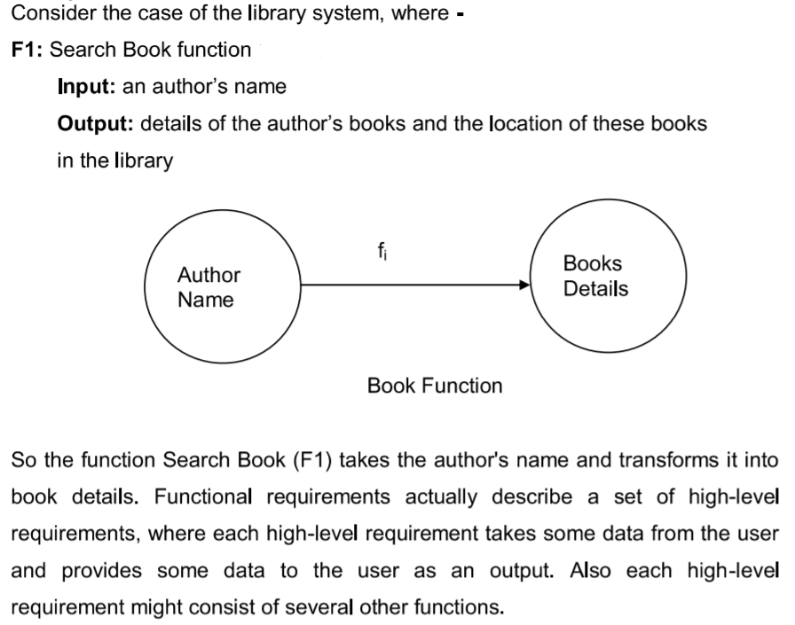
Example for Functional Requirement

Slide 39
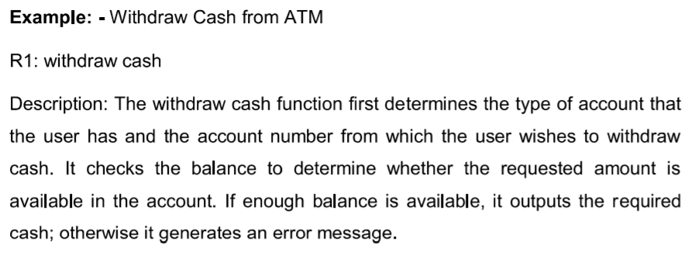
Documenting the Functional Requirement

Slide 40
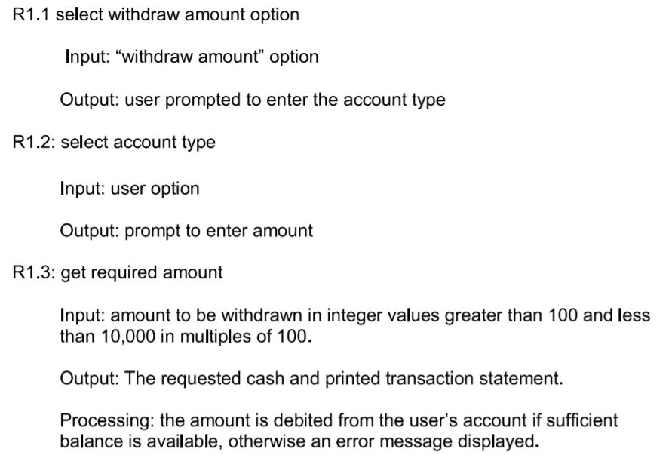
Documenting the Functional Requirement

Slide 41

Advantages of Functional Requirement
Helps you to check whether the application is providing all the functionalities that were mentioned in the functional requirement of that application
A functional requirement document helps you to define the functionality of a system or one of its subsystems.
Functional requirements along with requirement analysis help identify missing requirements. They help clearly define the expected system service and behavior.

Slide 42
Advantages of Functional Requirement
Errors caught in the Functional requirement gathering stage are the cheapest to fix.
Support user goals, tasks, or activities for easy project management
Functional requirement can be expressed in Use Case form or user story as they exhibit externally visible functional behavior.

Slide 43

What is Non-Functional Requirement?
A non-functional requirement defines the quality attribute of a software system.
They represent a set of standards used to judge the specific operation of a system. Example, how fast does the website load?
A non-functional requirement is essential to ensure the usability and effectiveness of the entire software system.
Failing to meet non-functional requirements can result in systems that fail to satisfy user needs.

Slide 44
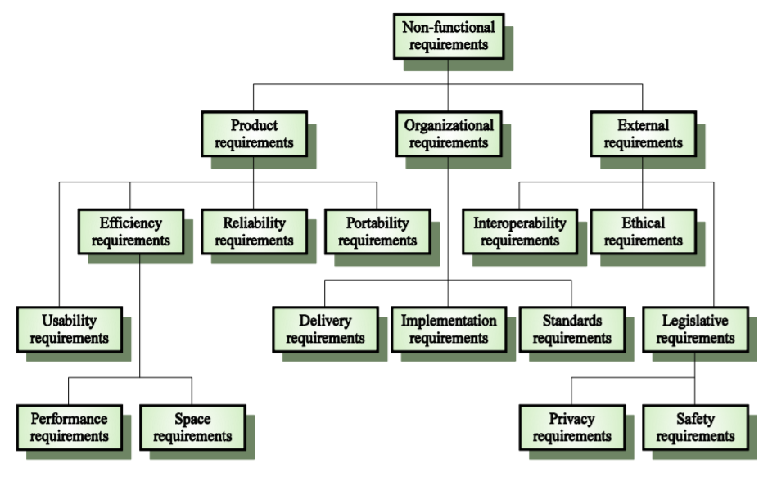
Non-Functional Requirement

Slide 45
Product Requirement
These requirements specify how software product performs. Product requirements comprise the following.
Usability requirements: Describe the ease with which users are able to operate the software. For example, the software should be able to provide access to functionality with fewer keystrokes and mouse clicks.
Efficiency requirements: Describe the extent to which the software makes optimal use of resources, the speed with which the system executes, and the memory it consumes for its operation. For example, the system should be able to operate at least three times faster than the existing system.
Reliability requirements: Describe the acceptable failure rate of the software. For example, the software should be able to operate even if a hazard occurs.
Portability requirements: Describe the ease with which the software can be transferred from one platform to another. For example, it should be easy to port the software to a different operating system without the need to redesign the entire software.

Slide 46
Organizational Requirement
These requirements are derived from the policies and procedures of an organization. Organizational requirements comprise the following.
Delivery requirements: Specify when the software and its documentation are to be delivered to the user.
Implementation requirements: Describe requirements such as programming language and design method.
Standards requirements: Describe the process standards to be used during software development. For example, the software should be developed using standards specified by the ISO and IEEE standards.

Slide 47
External Requirement
These requirements include all the requirements that affect the software or its development process externally. External requirements comprise the following.
Interoperability requirements: Define the way in which different computer based systems will interact with each other in one or more organizations.
Ethical requirements: Specify the rules and regulations of the software so that they are acceptable to users.
Legislative requirements: Ensure that the software operates within the legal jurisdiction. For example, pirated software should not be sold.

Slide 48
What is Non-Functional Requirement?
Non-functional Requirements allows you to impose constraints or restrictions on the design of the system across the various agile backlogs.
Example, the site should load in 3 seconds when the number of simultaneous users are > 10000. Description of non-functional requirements is just as critical as a functional requirement.

Slide 49

Examples of Non-functional requirements
A website should be capable enough to handle 20 million users with affecting its performance
The software should be portable. So moving from one OS to other OS does not create any problem.
Privacy of information, the export of restricted technologies, intellectual property rights, etc. should be audited.

Slide 50

Advantages of Non-Functional Requirement
The nonfunctional requirements ensure the software system follow legal and compliance rules.
They ensure the reliability, availability, and performance of the software system
They ensure good user experience and ease of operating the software.
They help in formulating security policy of the software system.

Slide 51
Functional VS Non Functional Requirements
Parameters | Functional Requirement | Non-Functional Requirement
What is it? | Verb | Attributes
Requirement | It is mandatory | It is non-mandatory
Capturing type | It is captured in use case. | It is captured as a quality attribute.
End-result | Product feature | Product properties
Capturing | Easy to capture | Hard to capture
Objective | Helps you verify the functionality of the software. | Helps you to verify the performance of the software.
Area of focus | Focus on user requirement | Concentrates on the user's expectation.

Slide 52
Qualities of Good Software Requirement Specification Document-Education Software system where a student can enroll for the course
Requirement Quality | Meaning | Example of bad requirement | Example of good requirement
Atomic | Self contained and capable of being understood independently of other requirements or designs | Students will be able to enroll to undergraduate and post graduate courses | Students will be able to enroll to undergraduate courses Students will be able to enroll to post-graduate courses
Complete | A requirement must be complete enough to guide further work at the appropriate level of detail for work to continue. | A professor user will log into the system by providing his username, password, and other relevant information | A professor user will log into the system by providing his username, password and department code

Slide 53
Qualities of Good Software Requirement Specification Document
Requirement Quality | Meaning | Example of bad requirement | Example of good requirement
Uniquely identified | to check for uniquely identified requirement. | 1- Students will be able to enroll to undergraduate courses 1- Students will be able to enroll to post-graduate courses | 1-Course Enrolment 1.1-Students will be able to enroll to undergraduate courses 1.2-Students will be able to enroll to post-graduate courses
Prioritized | A requirement must be ordered based on priority | Registered student-Priority 1 Maintain User Information-Priority 1 Enroll courses-Priority 1 View Report Card-Priority 1 | Register Student-Priority 1 Maintain User Information-Priority 2 Enroll courses-Priority 1 View Report Card-Priority3

Slide 54
Qualities of Good Software Requirement Specification Document
Requirement Quality | Meaning | Example of bad requirement | Example of good requirement
Consistent and unambiguous | A requirement must be consistent must not contradict or come into conflict with other requirements | A student will have either undergraduate courses or post-graduate courses but not both. Some courses will be open to both under-graduate and post-graduate | A student will have either undergraduate courses or post-graduate courses but not both.
Testable | able to verify that the requirement or design has been fulfilled | Each page of the system will load in an acceptable time-frame | Register student and enrol courses pages of the system will load within 5 seconds

Slide 55
Problems without a SRS document
The system would not be implemented according to customer needs.
Software developers would not know whether what they are developing is what exactly required by the customer.
Without SRS document, it will be very much difficult for the maintenance engineers to understand the functionality of the system.
It will be very much difficult for user document writers to write users' manuals properly.

Slide 56
Problems with an unstructured specification
It would be very much difficult to understand that document.
It would be very much difficult to modify that document.
Conceptual integrity in that document would not be shown.
The SRS document might be unambiguous and inconsistent.

Slide 57

User Requirement
Statements of what services the system is expected to provide to system users and the constraints under which it must operate
Often in Natural Language and no technical Details.
Determining what the user actually wants it to do is a difficult task.
The user is often not able to communicate the entirety of their needs and wants, and the information they provide may also be incomplete, inaccurate and self-conflicting.
The responsibility of completely understanding what the customer wants falls on the business analyst.
The business analyst carefully analyzes user requirements and carefully constructs and documents a set of high quality system requirements ensuring that that the requirements meet certain quality characteristics.

Slide 58
System Requirement
More detailed descriptions of the software systems function, services and operational constraints.
The system requirements document/ functional specification defines exactly what is to be implemented
It may be part of a contract between the system buyer and the software developers.

Slide 59
Requirements Engineering Process
The Process to gather the software requirements from client, analyse and document them is known as requirement engineering.
It provides the appropriate mechanism for understanding what the customer wants, analyzing need, assessing feasibility, negotiating a reasonable solution, specifying the solution unambiguously, validating the specification and managing the requirements as they are transformed into an operational system.
The goal of requirement engineering is to develop and maintain sophisticated and descriptive system requirements specification document

Slide 60
Requirements Engineering Process
The sub process of RE processes are
Feasibility Study: usefulness to the business
Elicitation and analysis : Discovering Requirements
Specification : Conversion of requirement into some standard form
Validation: Check the requirements which defines the system that the customer wants.

Slide 61
The requirements engineering process

Slide 62

Feasibility study
When the Client approaches the organization for getting the desired product developed, it comes up with a rough idea about what all functions the software must perform and which all features are expected from the software
Referencing to this information, the analyst do a detailed study about whether the desired system and its functionality are feasible or not.
A feasibility study decides whether or not the proposed system is worthwhile

Slide 63
Feasibility studies
Economic feasibility: An evaluation of development cost weighed against the ultimate income or benefit derived from the developed system or product
Technical feasibility: Evaluates the current technologies, which are needed to accomplish customer requirements within the time and budget.
Legal feasibility: A determination of any infringements, violation or liability that could result from the development of the system.
Alternatives: An evaluation of alternative approaches to the development of the system or product

Slide 64
Feasibility Report
1. Executive Summary
A summary of important findings and recommendations for further system development. Should be maximum of one page and self contained.
2. Introduction
A brief statement of the problem, the computing environment in which the system is to be implemented and constraints that affect the project. The scope of the problem should be defined.
3. Background
Discuss what others have done in relation to the problem. Define terms and other information which will be needed as background in order for the reader to understand the report.

Slide 65
Feasibility Report
4. Alternatives
A presentation of alternative system configurations; state the criteria that were used in selecting the final approach.
5. System Description
An abbreviated statement of scope of the system. Feasibility of allocated elements.
6. Cost-Benefit Analysis
An economic justification for the system.
7. Evaluation of Technical Risk
A presentation of technical feasibility.
8. Legal Ramifications

Slide 66
Feasibility studies
A feasibility study leads to a decision:
go ahead
do not go ahead
think again
In production projects, the feasibility study often leads to a budget request.
In research, a feasibility study is often in the form of a proposal.

Slide 67
Feasibility Study Implementation
Based on information assessment (what is required), information collection and report writing.
Questions for people in the organisation
What if the system wasn’t implemented?
What are current process problems?
How will the proposed system help?
What will be the integration problems?
Is new technology needed? What skills?
What facilities must be supported by the proposed system?

Slide 68
Requirements Engineering Processes
1. Requirements elicitation
What services do the end-users require of the system?
2. Requirements analysis
How do we classify, prioritise and negotiate requirements?
3. Requirements validation
Does the proposed system do what the users require?
4. Requirements management
How do we manage the (sometimes inevitable) changes to the requirements document?

Slide 69
Requirements Elicitation
In Requirements Engineering, Requirements Elicitation is the practice of researching and discovering the requirements of a system from users, customers, and other stakeholders.
A stakeholder is anyone affected by or who has an effect on the success of the project, such as end-users, clients, managers of end-users, and system administrators. A successful project addresses the needs of all stakeholders.
Stakeholders are end-users, managers, engineers involved in maintenance, Domain Experts , Trade Unions etc.
The practice is also sometimes referred to as “Requirement Gathering“.

Slide 70
Stakeholders for Healthcare Information System
Patients whose information is recorded in the system.
Doctors who are responsible for assessing and treating patients.
Nurses who coordinate the consultations with doctors and administer some treatments.
Medical receptionists who manage patients’ appointments.
IT staff who are responsible for installing and maintaining the system.
A medical ethics manager who must ensure that the system meets current ethical guidelines for patient care.
Healthcare managers who obtain management information from the system.
Medical records staff who are responsible for ensuring that system information can be maintained and preserved, and that record keeping procedures have been properly implemented.

Slide 71
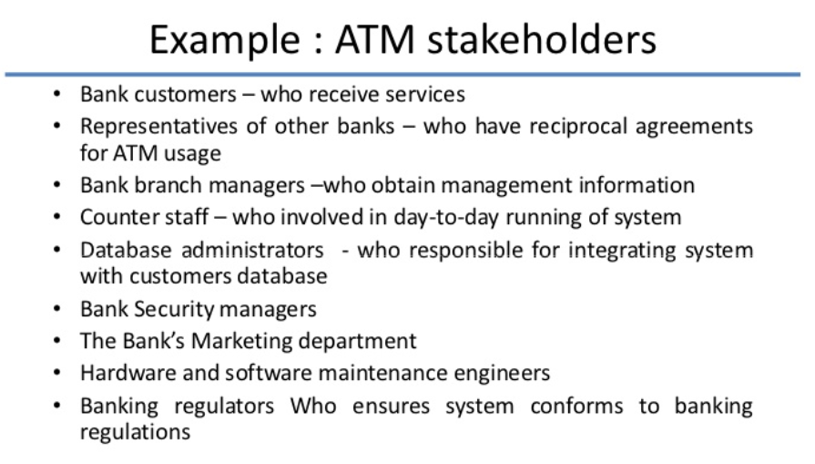
Case Study-Stakeholders for ATM

Slide 72
Requirement Discovery
The process of gathering information about the proposed and existing systems and distilling the user and system requirements from this information
Sources of information include documentation, System stakeholders and the specifications of similar systems
Approaches and Techniques of Requirements Discovery are
Viewpoint
Interviewing
Scenario
Use-cases

Slide 73
View Points
Recognizes multiple perspectives and provides framework for discovering conflicts in the requirements proposed by different stakeholders
VP are used as a way of classifying stakeholders and other sources of requirement
There are 3 generic types of VP:
Interactor viewpoints:
People or other systems that interact directly with the system. In an ATM, the customers and the account database.
Indirect Viewpoints
Indirect viewpoints have an ‘interest’ in some or all the services which are delivered by the system but do not interact directly with it In an ATM, the management and security staff are indirect viewpoints.
Domain viewpoints
Domain Characteristics and constraints that influence the requirements. In an ATM, an example would be standards for inter-bank communications

Slide 74
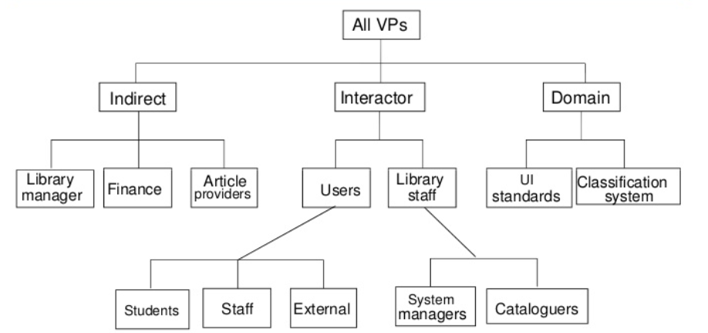
View Points for Library System

Slide 75
Interviewing
Used for getting an overall understanding of what stakeholders do and how they interact with system and difficulties they face with current system
There are two types of Interview
Closed interviews where a predefined set of questions are answered
Open interviews where there is no predefined agenda and a range of issues are explored with stakeholders
Interviews are good for getting an overall understanding of what stakeholders do and how they might interact with the system

Slide 76
Interview Questions
Who is behind the request for this work?
Who will use the solution?
What will be the economic benefit of a successful solution?
Is there another source for the solution that you need?
To Gain Better understanding of the problem and the customer to voice his or her perceptions about a solution
How would you characterize good output that would be generated by a successful solution
What problems will this solution address?
Can you show me the environment in which the solution will be used?
Will special performance issues or constraints affect the way the solution is approached?

Slide 77
The below questions focuses on the effectiveness of the meeting
Are you the right person to answer these questions? Are you answers Official?
Are my questions relevant to the problem that you have?
Am I asking too many questions?
Can anyone else provide additional information?
Should I be asking you anything else?

Slide 78
Scenarios
Scenarios are real life examples of how a system can be used
They should include
A description of what the system and user expect when the scenario starts
A description of the normal flow of events in the scenario
A description of what can go wrong and how this is handled
Information about other concurrent activities
A description of the state when the scenario finishes

Slide 79
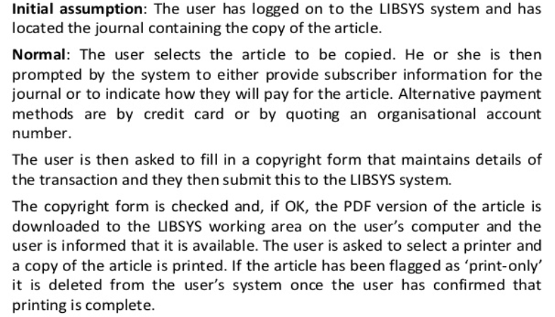
Library System -Scenario

Slide 80
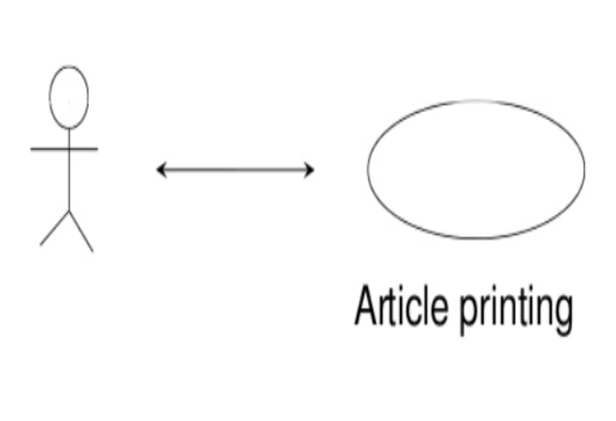
Use Cases
Use cases are a scenario based technique in the UML which identify the actors in an interaction and which describe the interaction itself.
A set of use cases should describe all possible interactions with the system
Actor-Stick Figure Use Case - Ellipse

Slide 81
Use-Case Diagram for Library System

Slide 82
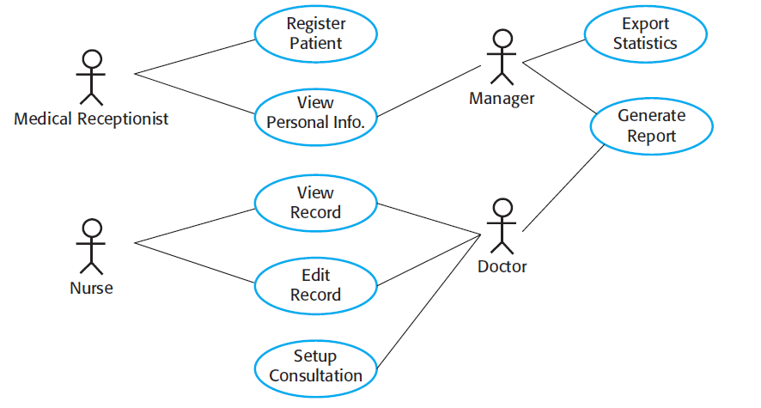
Use-Case Diagram for Healthcare System

Slide 83
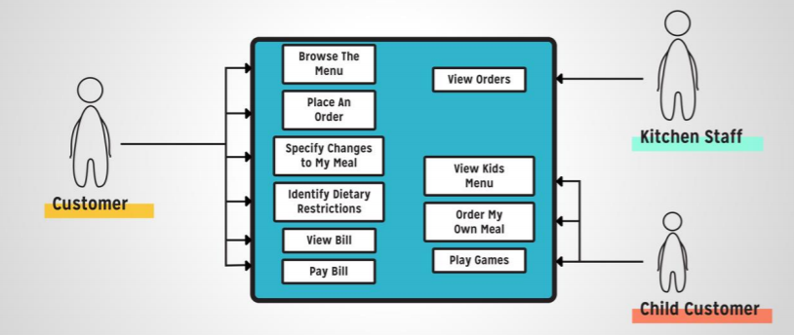
Use Cases(Restaurant Scenario)

Slide 84
Use Cases-View Bill

Slide 85
Use Cases

Slide 86
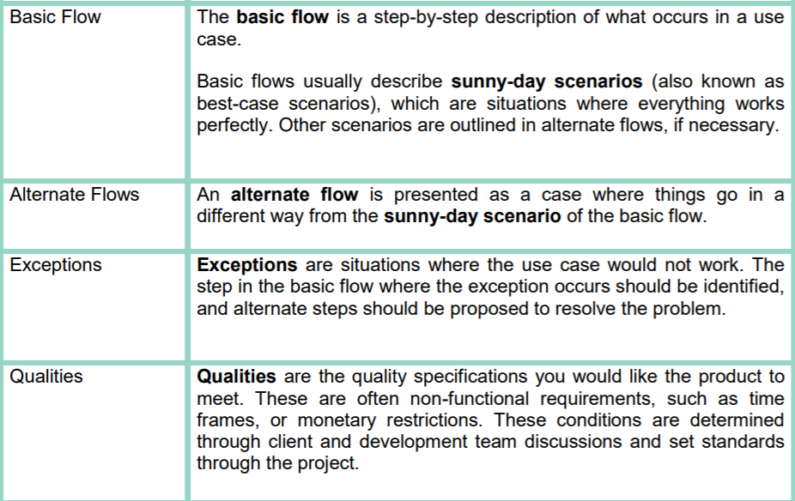
Use Cases

Slide 87
Library System –Sequence Diagram for Article Printing(Sequence diagrams may be used to add detail to use cases by showing the sequence of event processing in the system

Slide 88
Problems of Requirements elicitation
Stakeholders often don't know what they really want.
Stakeholders express requirements in their terms.
Stakeholders may have conflicting requirements.
Requirement change during the analysis process.
Organizational and political factors may influence system requirements.
The requirements change during the analysis process. New Stakeholders may emerge and the business environment change.

Slide 89
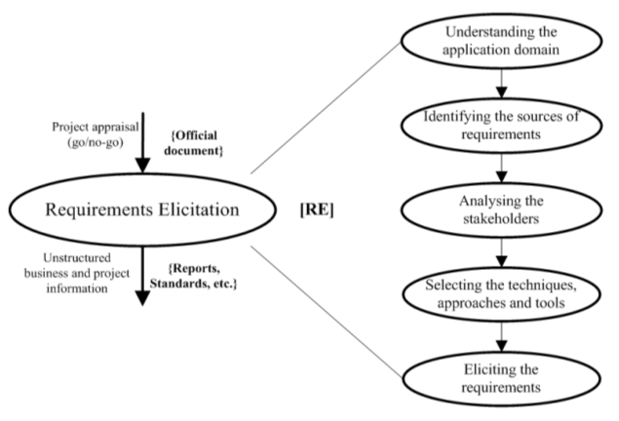
Requirements elicitation

Slide 90
Requirements Analysis
Requirement Analysis encompasses those tasks that go into determining the needs or conditions to meet for a new or altered product or project, taking account of the possibly conflicting Requirements of the various stakeholders, analyzing, documenting, validating and managing software or system requirements.
The requirements are analyzed to identify inconsistencies, defects, omission, etc.

Slide 91
Requirements Analysis
It is not unusual for customers and users to ask for more than can be achieved, given limited business resources.
It’s also relatively common for different customers or users to propose conflicting requirements, arguing that their version is essential for our special needs
You have to reconcile these conflicts through a process of negotiation
Using an iterative approach that prioritizes requirements, assesses their cost and risk and addresses internal conflicts, requirements are eliminated, combined or modified so that each party achieves some measure of satisfaction.

Slide 92
Elicitation and Analysis Process

Slide 93
Software Requirement Specification
Software requirement specification is a kind of document which is created by a software analyst after the requirements collected from the various sources
It is the job of the analyst to write the requirement in technical language so that they can be understood and beneficial by the development team.
Specification can be a written document, a set of graphical models, a formal mathematical model, a collection of usage scenarios, a prototype or combination of any of the above.
Specification is the final work product produced by the Requirement Engineer.

Slide 94
Different Type of Model
Data Flow Diagram:
Data Flow Diagrams (DFDs) are used widely for modeling the requirements.
DFD shows the flow of data through a system.
The system may be a company, an organization, a set of procedures, a computer hardware system, a software system, or any combination of the preceding
The DFD is also known as a data flow graph or bubble chart.

Slide 95
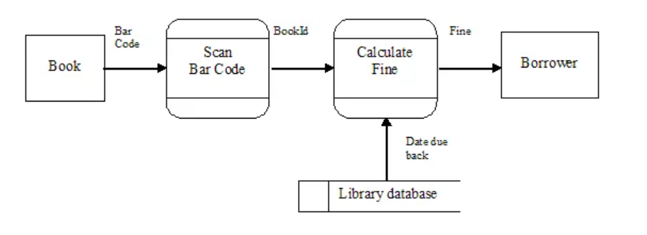
Data Flow Diagram for the Library Fine System

Slide 96
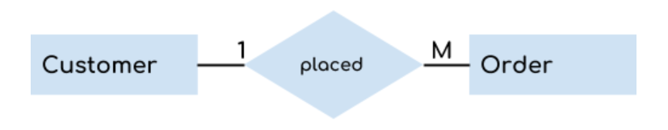
Entity-Relationship Diagram:
It is a detailed logical representation of the data for the organization and uses three main constructs i.e. data entities, relationships, and their associated attributes.
Often called an "E-R diagram."

Slide 97
Data Dictionary:
Data Dictionaries are simply repositories to store information about all data items defined in DFDs.
At the requirements stage, the data dictionary should at least define customer data items, to ensure that the customer and developers use the same definition and terminologies.

Slide 98
Requirements Validation
The development of software begins once the requirements document is 'ready'. For this, it is necessary to ensure that the requirements specification contains no errors and that it specifies the user's requirements correctly.
Requirements error costs are high so validation is very important
Fixing a requirements error after delivery may cost up to 100 times the cost of fixing an implementation error

Slide 99
Requirements validation
Requirements can be checked against the following conditions :
If they can practically implement
If they are correct and as per the functionality and specially of software
If there are any ambiguities
If they are full
If they can describe

Slide 100
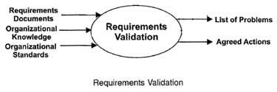
Requirements validation

Slide 101
Requirements management
Requirement management is the process of managing changing requirements during the requirements engineering process and system development.
New requirements emerge during the process as business needs a change, and a better understanding of the system is developed.
The priority of requirements from different viewpoints changes during development process.
The business and technical environment of the system changes during the development.

Slide 102
Requirements management
Once requirements have been identified, traceability tables are developed. Among many possible traceability tables are the following
Features traceability table: shows how requirements relate to important customer observable system/product features.
Source Traceability Table: Identifies the source of each requirement.
Dependency Traceability Table: Identifies how requirements are related to one another
Subsystem traceability table: Categorizes requirements by the subsystems that they govern.

Slide 103
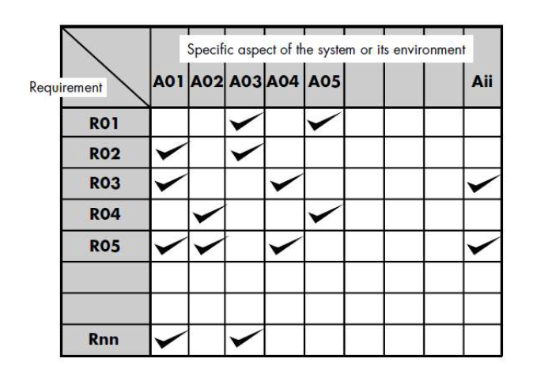
Requirements management

Slide 104
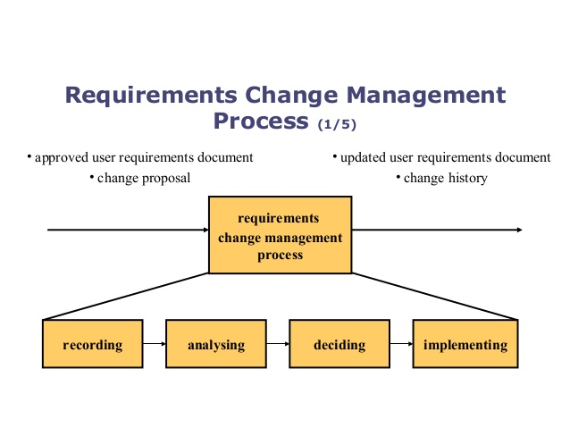
Requirements management

Slide 105
Facilitated Application Specification Technique(FAST)
This approach encourages the creation of a joint team of customers and developers who work together to identify the problem, propose elements of the solution, negotiate different approaches and specify a preliminary set of solution requirements.
The basic Guidelines:
A meeting is conducted at a neutral site and attended by both software engineers and customers.
Rules for preparation and participation are established
An agenda is suggested that is formal enough to cover all important points but informal enough to encourage the free flow of ideas.

Slide 106
Facilitated Application Specification Technique(FAST)
A facilitator(can be a customer, a developer or an outsider) controls the meeting
A definition mechanism(can be work sheets, flip charts or wall stickers or an electronic bulletin board, chat room) is used.
The goal is to identify the problem, propose elements of the solution, negotiate different approaches, and specify a preliminary set of solution requirements in an atmosphere that is conductive to the accomplishment of the goal.

Slide 107
Quality Function Deployment(QFD)
Quality function deployment (QFD) is a quality management technique that translates the needs of the customer into technical requirements for software.
QFD "concentrates on maximizing customer satisfaction from the software engineering process“
QFD identifies three types of requirements
Normal requirements.
The objectives and goals that are stated for a product or system during meetings with the customer. If these requirements are present, the customer is satisfied.
Examples of normal requirements might be requested types of graphical displays, specific system functions, and defined levels of performance.

Slide 108
Quality Function Deployment(QFD)
Expected requirements.
These requirements are implicit to the product or system and may be so fundamental that the customer does not explicitly state them. Their absence will be a cause for significant dissatisfaction.
Examples of expected requirements are: ease of human/machine interaction, overall operational correctness and reliability, and ease of software installation.
Exciting requirements.
These features go beyond the customer's expectations and prove to be very satisfying when present.
For example, software for a new mobile phone comes with standard features, but is coupled with a set of unexpected capabilities (e.g., multitouch screen, visual voice mail) that delight every user of the product

Slide 109
System prototyping
Rapid software development to validate requirements
Prototyping is the process of quickly putting together a working model in order to test various aspects of a design, illustrate ideas or features and gather early user feedback.
Uses of system prototypes:
The principal use is to help customers and developers understand the requirements for the system
Prototyping can be considered as a risk reduction activity which reduces requirements risks

Slide 110
Prototyping benefits
Misunderstandings between software users and developers are exposed
Missing services may be detected and confusing services may be identified
A working system is available early in the process
The prototype may serve as a basis for deriving a system specification
The system can support user training and system testing
Improved system usability
Closer match to the system needed
Improved design quality
Improved maintainability
Reduced overall development effort

Slide 111
Prototyping Process

Slide 112
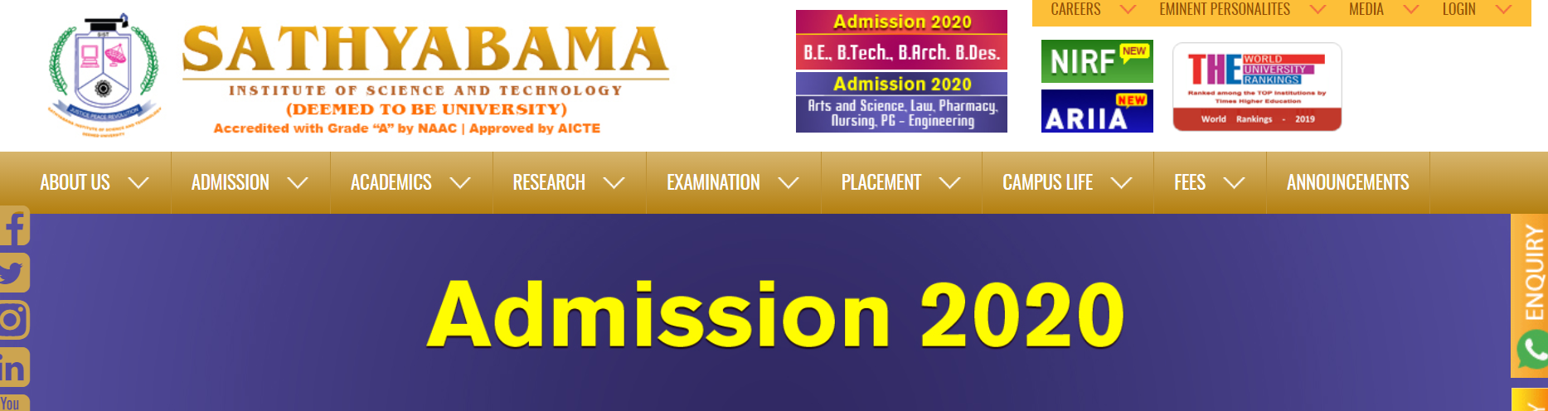
Sample Prototype

Slide 113
Prototyping in the software process
Evolutionary prototyping
An approach to system development where an initial prototype is produced and refined through a number of stages to the final system
Throw-away prototyping
A prototype which is usually a practical implementation of the system is produced to help discover requirements problems and then discarded. The system is then developed using some other development process

Slide 114
Approaches to prototyping

Slide 115
Evolutionary Prototyping
Iterative Model
Based on the idea of developing initial implementation
Refine the Model

Slide 116
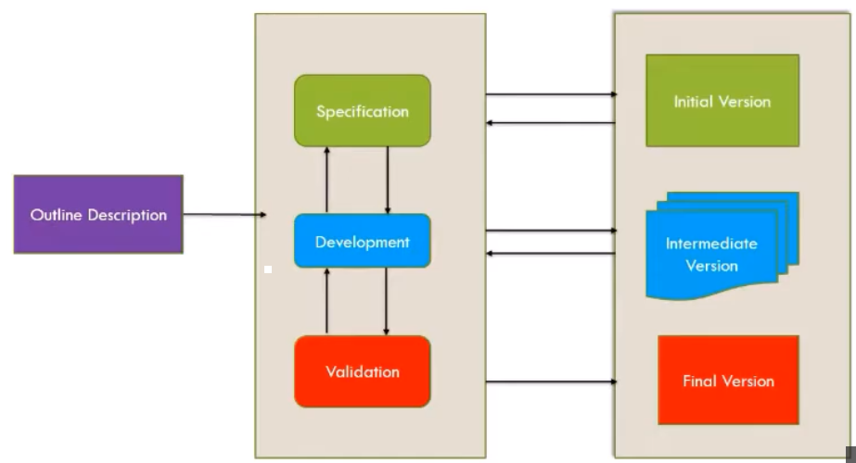
Evolutionary Prototyping

Slide 117
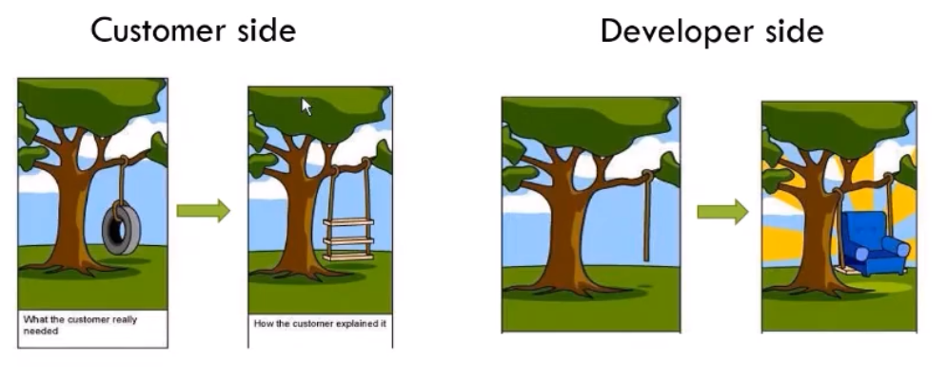
Evolutionary Prototyping

Slide 118
Evolutionary Prototyping

Slide 119
Evolutionary Prototyping Advantages
Accelerated delivery of the system
Rapid delivery and deployment are sometimes more important than functionality or long-term software maintainability
User engagement with the system
Not only is the system more likely to meet user requirements, they are more likely to commit to the use of the system

Slide 120
Throw-away prototyping
rapid or close ended prototyping
This type of prototyping uses very little efforts with minimum requirement analysis to build a prototype.
Once the actual requirements are understood, the prototype is discarded and the actual system is developed with a much clear understanding of user requirements.
The throw-away prototype should NOT be considered as a final system
Some system characteristics may have been left out
There is no specification for long-term maintenance
The system will be poorly structured and difficult to maintain

Slide 121
User interface prototyping
It is impossible to pre-specify the look and feel of a user interface in an effective way. prototyping is essential
UI development consumes an increasing part of overall system development costs
User interface generators may be used to ‘draw’ the interface and simulate its functionality with components associated with interface entities
Web interfaces may be prototyped using a web site editor

Slide 122
Techniques for User Interface Prototyping
Work with the real users.
Get your stakeholders to work with the prototype.
Understand the underlying business
You should only prototype features that you can actually build
You cannot make everything simple
It's about what you need.
Get an interface expert to help you design it.
Explain what a prototype is.
Consistency is critical.
Avoid implementation decisions as long as possible
Small details can make or break your user interface

Slide 123
Data Modeling-ER Diagram
Examines data objects independently of processing
Focuses attention on the data domain
Creates a model at the customer's level of abstraction
Indicates how data objects relate to one another
Data Objects
A data object can be an external entity , a thing ,an occurrence or event ,a role, an organizational unit, a place, or a structure.

Slide 124
Data Modeling
Attributes
Data attributes define the properties of a data object
In addition, one or more of the attributes must be defined as an identifier
The identifier attribute becomes a "key" when we want to find an instance of the data object.
They can be used to
(1) name an instance of the data object,
(2) describe the instance, or
(3) make reference to another instance in another table

Slide 125
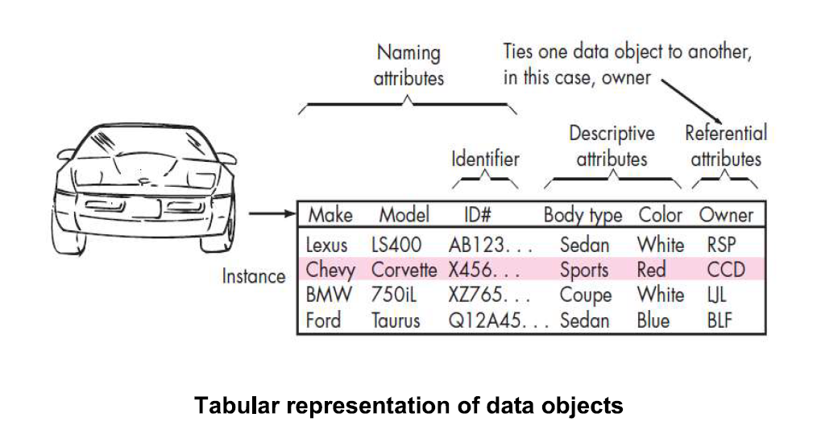
Data Modeling
(2) describe the instance, or
(3) make reference to another instance in another table

Slide 126
Data Modeling
Relationships
Data objects are connected to one another in different ways.
Consider the two objects person and car ,
A connection is established between them because they are related.
For example
A Person owns a car
A Person is insured to drive a car

Slide 127
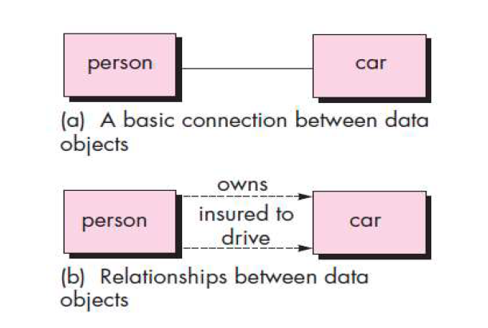
Data Modeling

Slide 128
Cardinality
One-to-one (I:1)—An occurrence of [object] 'A' can relate to one and only one occurrence of [object] 'B,' and an occurrence of 'B' can relate to only one occurrence of 'A.'
One-to-many (1:M)—One occurrence of [object] 'A' can relate to one or many occurrences of
[object] 'B,' but an occurrence of 'B' can relate to only one occurrence of 'A.'
Many-to-many (M:N)—An occurrence of [object] 'A' can relate to one or more occurrences of 'B,' while an occurrence of 'B' can relate to one or more occurrences of 'A.'
Cardinality defines "the maximum number of objects that can participate in a relationship“ It does not, however, provide an indication of whether or not a particular data object must participate in the relationship.

Slide 129
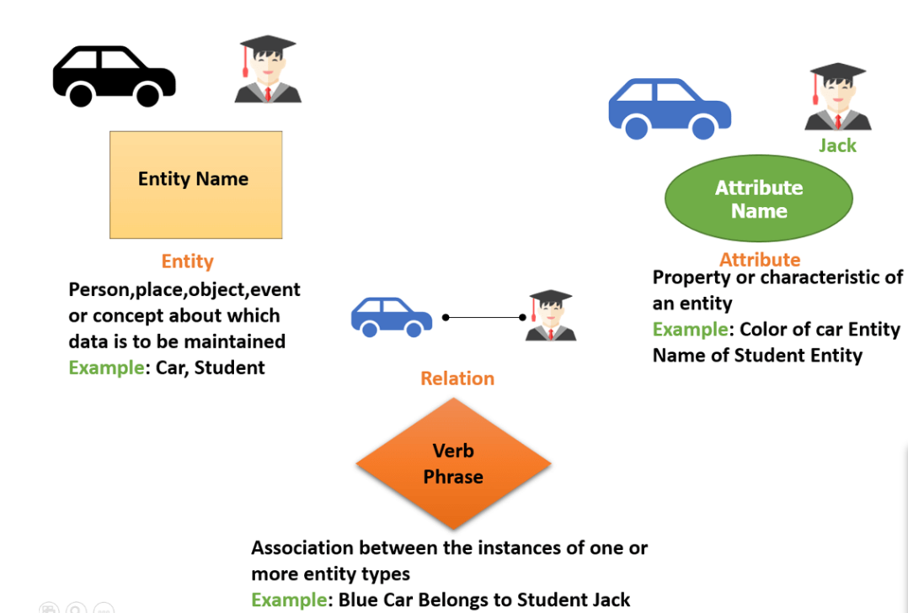
Symbols used in ER Diagram

Slide 130
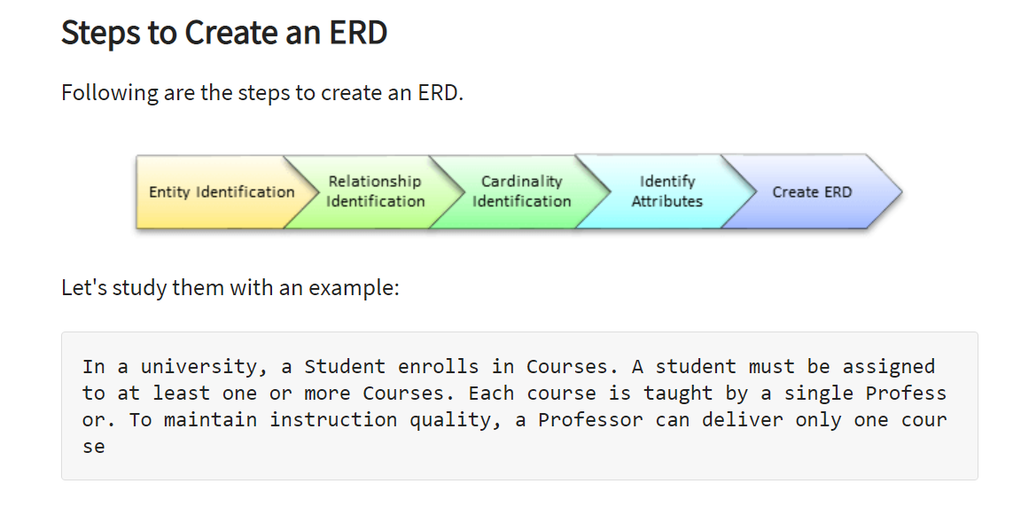
ER Diagram

Slide 131
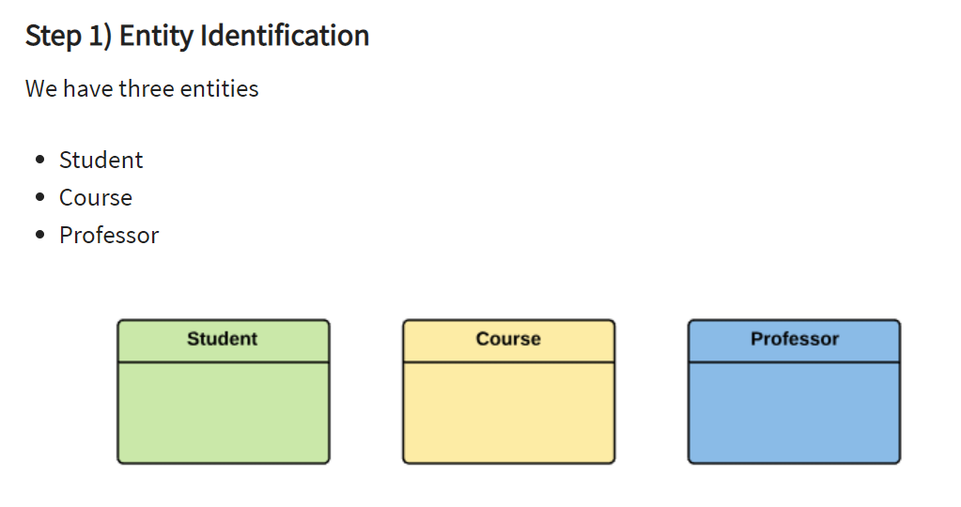
ER Diagram

Slide 132
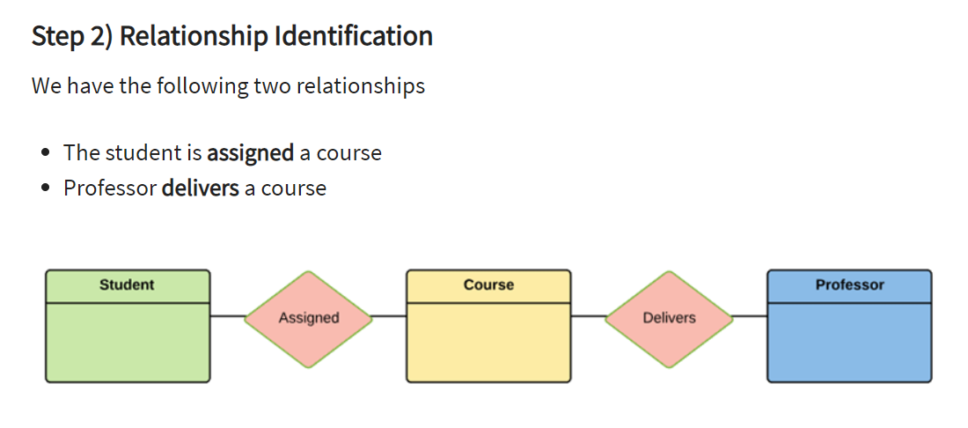
ER Diagram

Slide 133
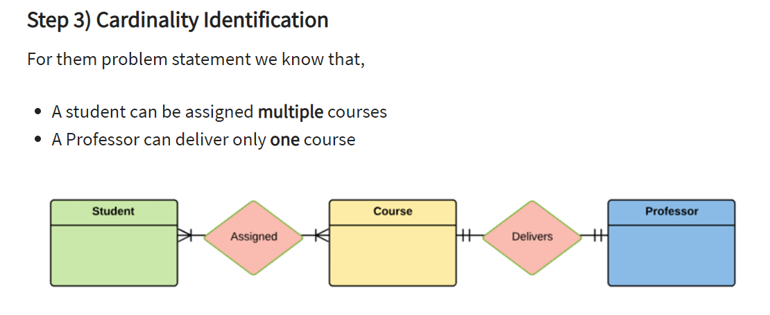
ER Diagram

Slide 134
ER Diagram

Slide 135
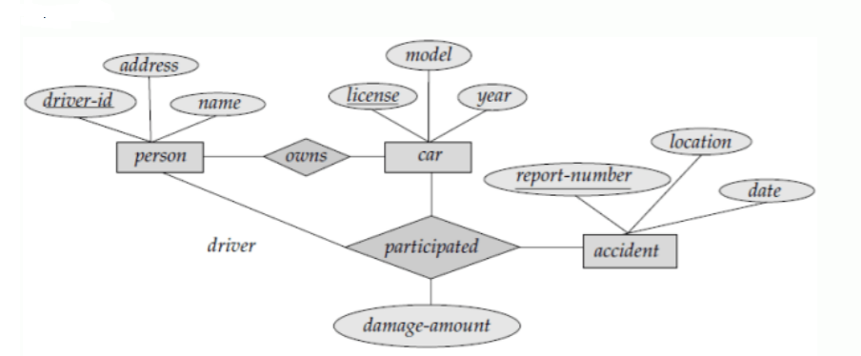
E-R diagram for a car-insurance company

Slide 136
Functional Model-Data Flow Diagram
A Data Flow Diagram(DFD) is a graphical representation of the flow of data through an information system
DFDs can be used for the visualization of data processing(structured Design)
It views a system as a function that transform the input into desired output
Flow Chart shows flow of control
DFD shows flow of Data
The flowchart describes boxes that describe computations, Decisions, Interactions and loops

Slide 137
Steps for Creating Data Flow Diagram
Create a list of activities
Construct Level 0 DfD(Identifies Sources and Sink)
Construct Level 1DFD(identifies manageable sub processes)
Construct Level 2-n DFD
DFDs can be used for the visualization of data processing(structured Design)
It views a system as a function that transform the input into desired output
Flow Chart shows flow of control
DFD shows flow of Data

Slide 138

0-Level DFD It shows the system as a single process with its relationship to external entities

Slide 139

1-Level DFD In this level we highlight the main functions of the system

Slide 140

2-Level DFD 2-level DFD goes one step deeper into parts of 1-level DFD. It can be used to plan or record the specific/necessary detail about the system’s functioning

Slide 141
Behavioral Model-State Transition Diagram
Rectangle represents system states
Arrow represents transition between states
Each Arrow labeled with Rule expression
Top value indicates the events that cause the transition to occur
Bottom Value indicates the action that occurs as a consequence of the event
In Photocopier Software
When the paper tray is full and start button is pressed, the system moves from the reading commands state to making copies state

Slide 142

Behavioural Model-State Transition Diagram

